Slide 1

Presented By:
Pinkesh Kumar
Chiruhasini Sammeta
S Guna Sekhar Babu
Engr. Muhammad Umer
Date : 25/12/2022

Slide 2
Abstract:
Home automation using Arduino(picsimlab) and Blynk application.
Controlling Garden Lights based on whether it is Day or Night.
Controlling cooler and heater based on whether it is Hot or Cold also sending respective notification to LCD and mobile application.
Controlling water level of the tank based on its capacity and , also sending respective notification to LCD and mobile application.

Slide 3
What we learnt in this internship:
Week 1:
C programming and its Data Types.
Conditional statement and Different types of operators.
Pointers and Functions.
String manipulation and Storage classes.

Slide 4
C programming:- where it is used and it’s characteristics.
Key words:-
Basic data types,modifiers,Qualifiers,loops,jumps etc….,
Data representation,Basic Data types,Conditional constructs,
Operators ,Array ,Pointers.
Embedded C - Recursion, Const with pointers and strings.
Embedded C – Pre processor and UDT structures, storage classes.

Slide 5
What we learnt in this internship:
Week 2:
Introduction to C++ classes , object creation.
Constructors and Destructors.
Introduction to IOT and its applications.
Installation of Arduino IDE , Null modem emulator , Picsimlab and all other required libraries.
Week 3 and week 4 , we started building our Home automation Project.

Slide 6
Introduction to Iot:-
The Internet of Things (IoT) is the network of physical objects that contain embedded technology to communicate and sense or interact with their internal states or the external environment.
These devices range from ordinary household objects tosophisticated industrial tools. With more than 7 billion connected loT devices today, experts are expecting this number to grow to 10billion by 2020 and 22 billion by 2025.
By means of low-cost computing, the cloud, big data, analytics, and mobile technologies, physical things can share and collect data with minimal human intervention. In this hyper connected world, digital systems can record, monitor, and adjust each interaction between. connected things. The physical world meets the digital world-and they cooperate.

Slide 7
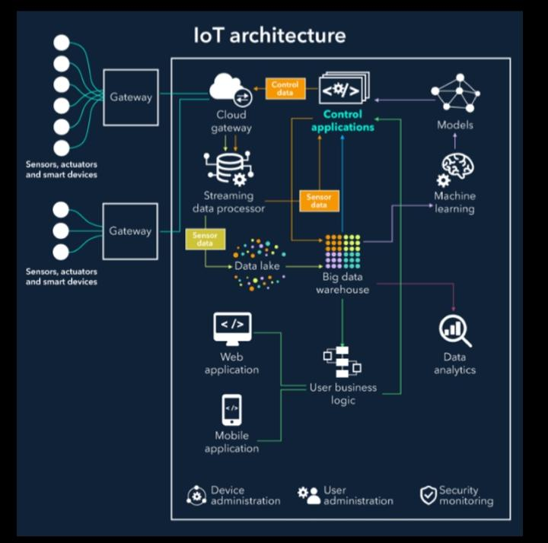
Iot architecture:-

Slide 8
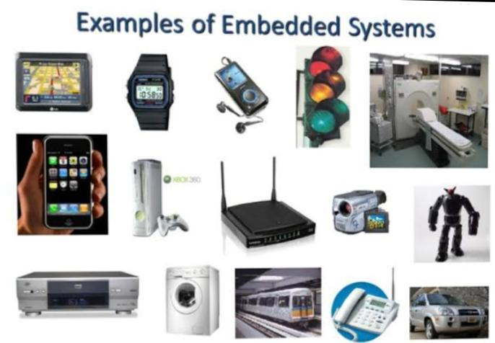
Embedded systems:-
Any combination of hardware and software which is intended to do a specific task can be called an Embedded System.
It has 3 parts; software, firmware and hardware.• Unlike computers, embedded systems perform few specific limited tasks.
Embedded Devices have peripherals such as Serial Communication Interfaces (SCI), Synchronous Serial Communication Interface, Universal Serial Bus (USB), Multi Media Cards (SD cards, Compact Flash) etc.

Slide 9
Overview:
Purposes:
The purpose of the document is to understand the requirements of “Home Automation using Arduino (picsimlab)and Blynk application ”. This document will be used by the students to develop the project. This document will also be used for requirement validation.
Scope:
The Home automation should be simulated on the picsimlab simulator, Blynk iot mobile applications used to control the devices . Should be able to control the lights, temperature of the home , inflow and outflow of water in the water tank.

Slide 10

Assumption and Dependencies
Assumptions
All the peripheral are simulated and no real time objects are interfaced.
Dependencies
Based on Blynk app we are controlling devices.

Slide 11
Requirements:-
Software requirements:-
ARDUINO IDE: To code
•PICSIMLAB: For simulation• LCD HD44780
NULL MODEM EMULATOR: To configure port of serial removal tank.
Blynk IOT app: Cloud server.

Slide 12
Requirements:-
Hardware requirements:-
ARDUINO UNO
• ETH-W5500
• PCF-8574
• TEMPERATURE SENSOR
• LCD HD44780
• LDR SENSOR
• LED

Slide 13
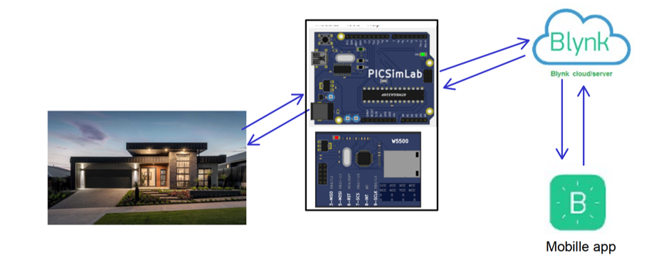
Functional Requirements

Slide 14
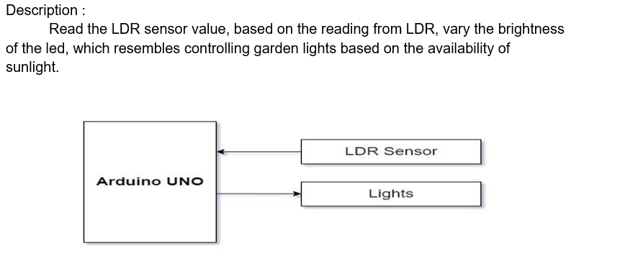
Garden light control

Slide 15
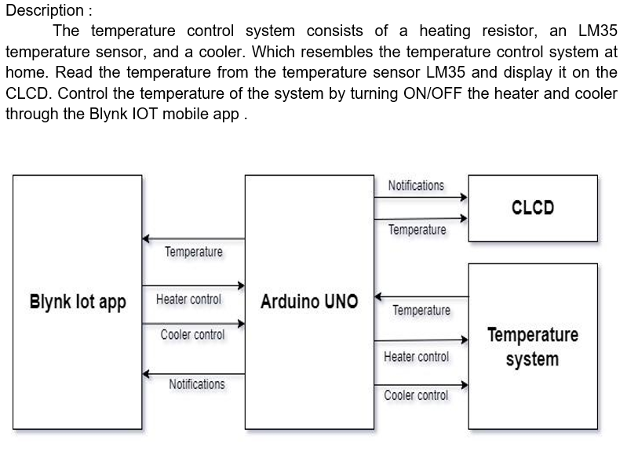
Temperature Control System

Slide 16
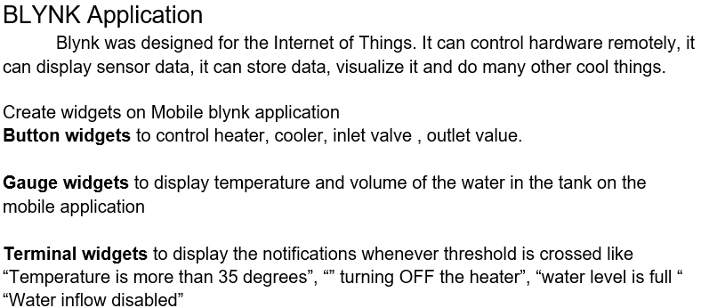
User interfaces

Slide 17
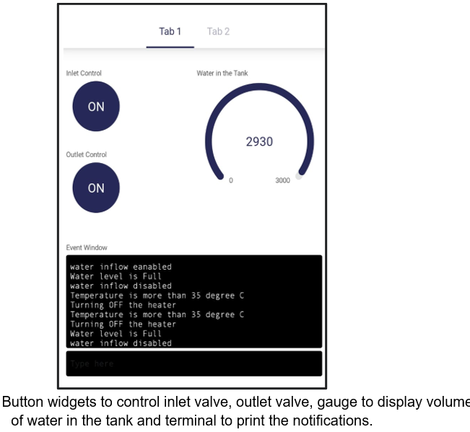
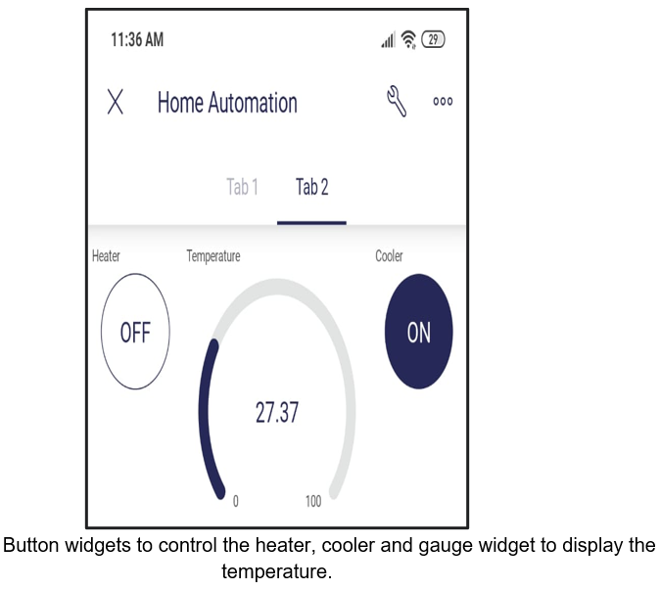
Blynk iot app

Slide 18
Arduino Uno:-
Arduino UNO is based on an ATmega328P microcontroller
.It is easy to use compared to other boards, such as the Arduino Mega board, etc.
The board consists of digital and analog Input/ Output pins (I/O), shields, and other circuits
The Arduino UNO includes 6 analog pin inputs, 14 digital pins, a USB connector, a power jack, and an ICSP (In-Circuit Serial Programming) header.
It is programmed based on IDE, which stands for Integrated Development Environment. It can run on both online and offline platforms

Slide 19
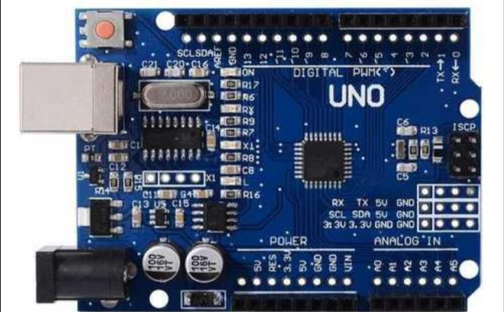

Slide 20
ETH W5500:-
The W5500 chip is a Hardwired TCP/IP embedded Ethernet controller that provides easier Internet connection to embedded system.
W5500 enables users to have the Internet connectivity in their applications just by using the single chip in which TCP/IP stack, 10/100 Ethernet MAC and PHY embedded.
Supports Power down mode.
Supports Wake on LAN over UDP. Supports High Speed Serial Peripheral Interface(SPI MODE 0,3).

Slide 21
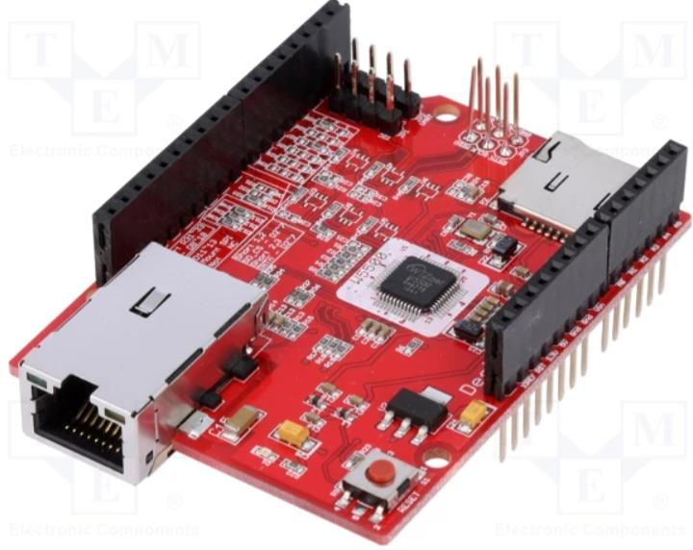

Slide 22
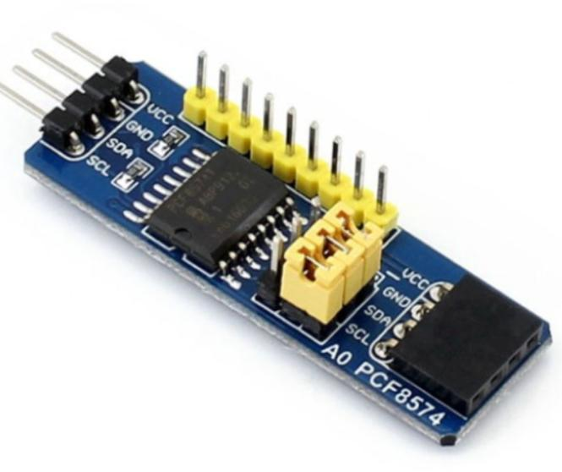
PCF-8574:-
The PCF8574 is a silicon CMOS circuit.
It provides general purpose remote I/O expansion for most microcontroller families via the two-line bidirectional bus (12C).
The device consists of an 8-bit quasi-bidirectional port and an12C-bus interface.

Slide 23
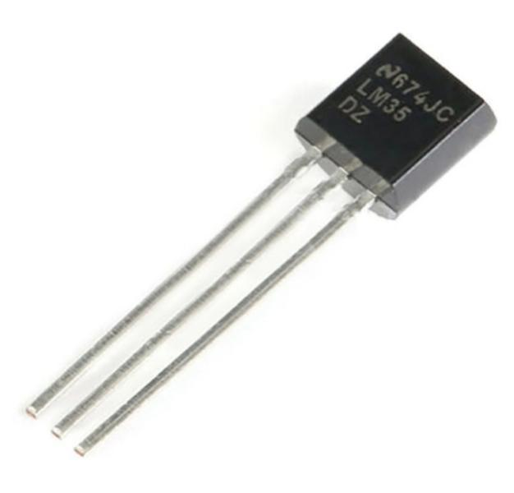
Temperature sensor:-
A Temperature sensor is an electronic device that measure the temperature of its environment and converts the input data into electronic data to record, monitor, or signal Temperature changes.

Slide 24
Threshold control
When the heater is ON if the temperature rises above 35 degree celsius then heater should turn OFF automatically and message “Temperature is more than 35 degree Celsius Turning OFF the heater” should be displayed on the virtual terminal, “HT_R OFF” on CLCD.
When the water in the tank is full, turn off the inlet valve automatically and display “water level is full water inflow disabled” .

Slide 25
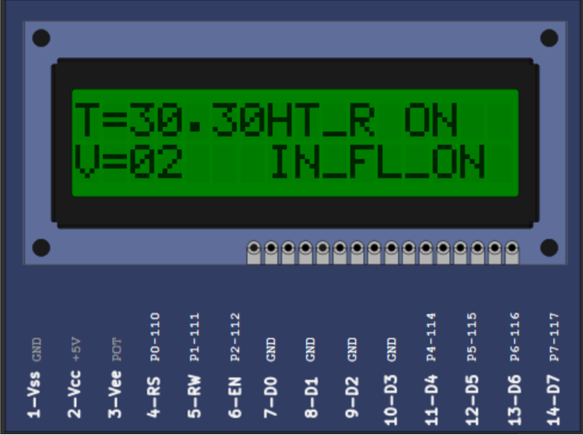
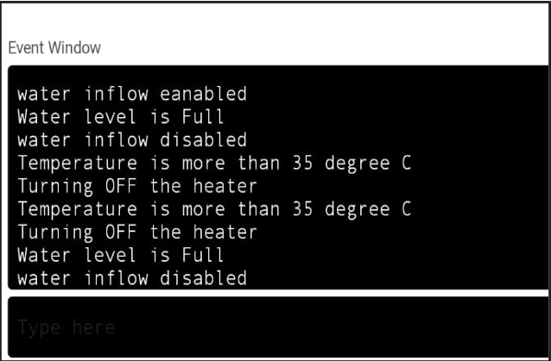
Notification

Slide 26
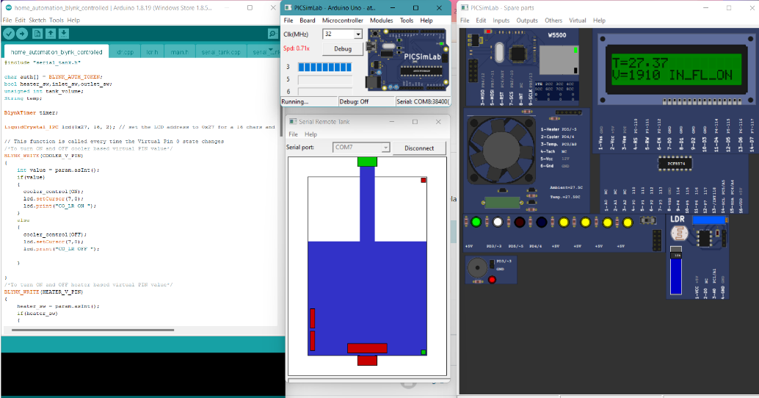
Project images:

Slide 27
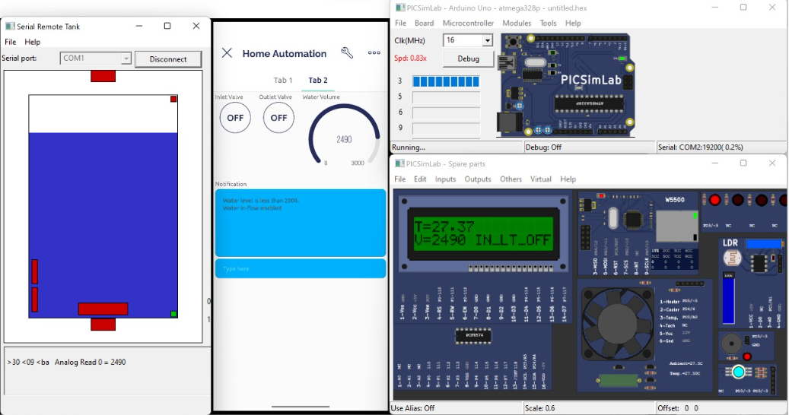
Project images:

Slide 28
Conclusion
Using BLYNK Iot application and Picsimlab simulator, simulated home automation, where LED, temperature system, Serial tank resembles Light, Heater, Cooler and Water tank in real time.
CLCD acts like a dashboard used for displaying the events, Widgets from Blynk Iot app like button widgets are used to control heater, cooler and inlet valve, outlet valve.
Gauge widgets to display the temperature and volume of the water.

Slide 29
Thank you
@EMERTXE

